Slide 1
Course Selection
How to make the most of your schedule!

Slide 2
Core Classes
(Language Arts, Math, Science, and Social Studies)
Students will be scheduled into the academically appropriate course with the school counselor based off the current course progression chart (available online).

Slide 3
Language Arts
English 1
AICE General Paper
English 1 through ESOL

Slide 4
Math
Foundational Math & Algebra 1
Algebra 1
Algebra 1 Honors
Geometry
Geometry Honors
Algebra 2
Algebra 2 Honors

Slide 5
Science
Environmental Science
Environmental Science Honors
Biology Honors
Chemistry 1 Honors

Slide 6
Social Studies
(Select 1 or 2)
Financial Literacy & Promotional Design Management
Financial Literacy Honors & Promotional Design Management
AP Human Geography
AICE Human Geography

Slide 7
Personalization Period
Study Hall
Learning Strategies

Slide 8
Reading
Students who receive a 1 on the FAST Test or who are identified as an English Language Learner will be scheduled into the appropriate reading course.
This will count for one of the elective courses.

Slide 9
Pathways – NEW!!!
Students will choose 1 pathway that they will follow for a multi-year commitment.
You will have an opportunity to learn more about each pathway at a special event later this month.
Number your top 5 pathway choices on the course card.

Slide 10
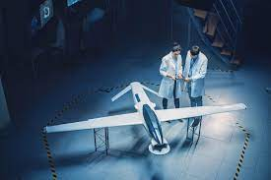
Aerospace
Aerospace 1 Honors
Principles of Aeronautical Design (DE)
Unmanned aircraft systems operations (DE)
Private Pilot Operations (DE)

Slide 11

Computer Science
Advanced IT Honors
Foundations of Programming
AP Computer Science Principles
AP Computer Science Principles A
This Photo by Unknown Author is licensed under CC BY-SA-NC

Slide 12

Culinary
Culinary 1
Culinary 2
Culinary 3

Slide 13

Cyber Security
IT Fundamentals
Computer and Network Security Fundamentals
Cybersecurity Essentials
Operational Cybersecurity

Slide 14

Engineering
Intro to Engineering Design
Principles of Engineering
Computer Integrated Manufacturing
Engineering Design and Development
Civil Engineering and Architecture

Slide 15

Health Science
Anatomy & Physiology Honors
Health Science Foundations
Allied Health Assisting
Electrocardiograph Technician (EKG)

Slide 16

JROTC
Leadership Education & Training 1
Leadership Education & Training 2
Leadership Education & Training 3
Leadership Education & Training 4

Slide 17

Law Studies
Constitutional Law
Law Studies
Comprehensive Law Honors
Court Procedures

Slide 18

Marketing
Marketing Essentials
Marketing Applications
Marketing Management
Principles of Management – On Campus Dual Enrollment

Slide 19

Robotics
Foundations of Robotics
Robotic Design Essentials
Robotic Systems
Robotic Applications Capstone

Slide 20

TV Production
Digital Video Tech 1 Honors
Digital Video Tech 2 Honors
Digital Video Tech 3 Honors

Slide 21
Reasons to earn Industry Certification:
Certification that can be used in the real world
Looks great on college application
Looks great on resume
Eligible for different scholarship opportunities
Graduation Cord

Slide 22
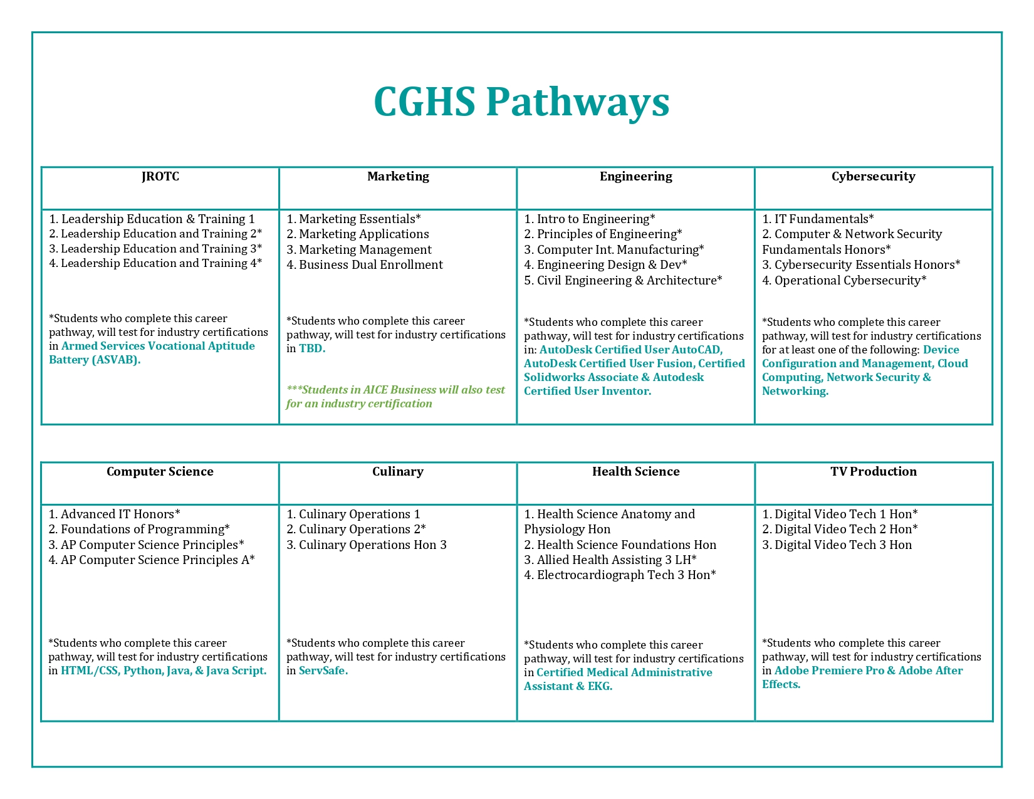
Industry Certifications at Coral Glades High School

Slide 23
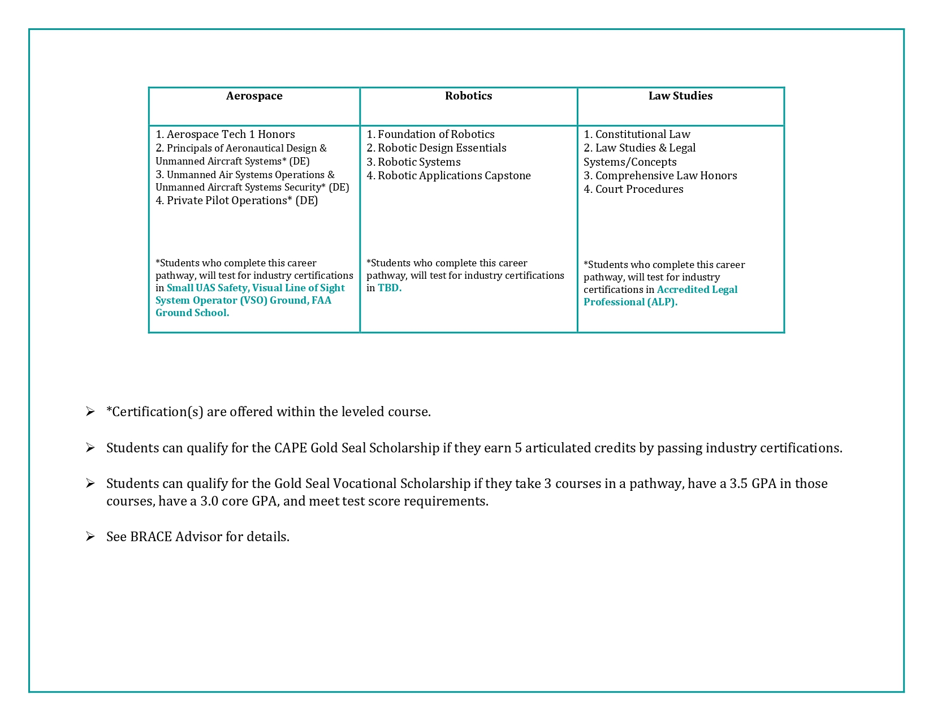
Industry Certifications at Coral Glades High School

Slide 24
Electives
Students will receive up to 2 elective courses.
Electives do NOT require a multi-year commitment.
Number your top 5 elective choices on your course card.

Slide 25
Cambridge Electives
AICE Thinking Skills

Slide 26
Fine Arts Electives
1 credit of Fine Arts is required for graduation.
Most pathways & debate count as a Fine Arts credit. Check with your counselor for details.
Band, Orchestra, Color Guard and Dance will require participation beyond the regular school day.

Slide 27
Fine Arts Electives
Music
3 levels of Band
Guitar
Color Guard
Orchestra
2 levels of Chorus
Piano Keyboarding
GarageBand Production

Slide 28
Fine Arts Electives
Additional
2-D Art
Ceramics
Intro to Film
Theater
Acting
Dance

Slide 29
World Languages Electives
2-3 years of the same language are recommended for college.
However, World Languages is not a graduation requirement.
Spanish
Spanish Speakers
French
American Sign Language (ASL)

Slide 30
Physical Education Electives
1 semester of any PE AND 1 semester of health is needed for graduation.
Choosing the first option will allow for you to meet both requirements in 1 school year.
Health (online)/ PE
Team Sports
Weight Training
Yoga

Slide 31
PE - Waiver
2 years of JROTC or 2 full seasons of JV or Varsity Athletics counts as the PE & Health graduation requirements.
Dance and Advanced Band can satisfy the PE half credit. However, it does not meet the requirement for Health.

Slide 32
Additional Electives
Creative Writing
Debate
Newspaper
Yearbook
Student Government LH
Latinos in Action LH

Slide 33
Next Steps
Receive course cards from middle school
Review course cards with your parents/guardians.
Teacher signature process
Turn course card back into Assigned Teacher
Meeting with HS counselor to pick courses next month.
Remember, nothing is guaranteed to be on your schedule ☺

Slide 34
Students
Set your goals, be active in extra-curricular activities
work hard & have a Great High School Experience !

Slide 35


Advanced Academics at
Coral Glades High School
Principal: Dr. Mark J. Kaplan
Advanced Academics Coordinator: Lisa Plass

Slide 36

Benefits of Cambridge
International High School Diploma
College Credit (must sit for and pass the international exam.)
Weighted GPA
Rigorous course work
Automatic Bright Futures Scholarship Qualifier (Students still need the 100 service hours)

Slide 37
Coral Glades Cambridge Program Offerings
Group 1
Mathematics and Sciences
___Marine Science
___Environmental Science
(1 or 3)
___Psychology (1 or 3)
Group 3
Arts and Humanities
___ Geography
___ European History
___U.S. History
___Psychology (1 or 3)
___Environmental Science (1 or 3)
___Media Studies AS
___Media Studies A
___Business
Group 4
Interdisciplinary and Skills-based (Optional)
_____ English General Paper
_____ Thinking Skills
_____Global Perspectives A lvl
(Only 2 credits from group 4.)
Compulsory
___Global Perspectives AS lvl
Group 2
Languages
_____ English Language
_____ Spanish Language
AICE Psychology can count for either Group 1 or Group 3 towards the AICE diploma, and it is considered an academic elective to colleges. However, it counts as an elective credit on the high school transcript- not a math or science credit.
* within a 25-month period- a student who starts the program as a freshman, has until the end of junior year to complete the requirements, and a student who starts the program as a sophomore, has until the end of senior year to complete the requirements.

Slide 38
English General Paper - 9th grade students who have scored an appropriate level on the state exam.
Thinking Skills – Students who are enrolled in geometry or higher
AICE Geography- Students who have scored an appropriate level on the state exam.
Coral Glades Expectations

Slide 39

Benefits of
Advanced Placement
College Credit (must sit for and pass the national exam.)
Weighted GPA
Rigorous course work

Slide 40
AP Human Geography- 9th grade students who have scored a level 3 or higher on the state exam.
Many options for students in grades 10-12
Advanced Placement in 9th Grade

Slide 41


Advanced Placement 2023-2024
Mathematics
Calculus AB
Calculus BC
Statistics
Pre-Calculus
Electives
Spanish Language
Spanish Literature
French
Music Theory
Art History
2D Art
3D Art
Drawing
Psychology
Comp Sci principles
Comp Sci A
English
English Language
English Literature
Social Studies
Human Geography
U.S. History
U.S. Government
Science
Biology
Chemistry
Environmental Science
Capstone Diploma
Take and pass Seminar year 1 and Research year 2 plus four additional AP classes.

Slide 42
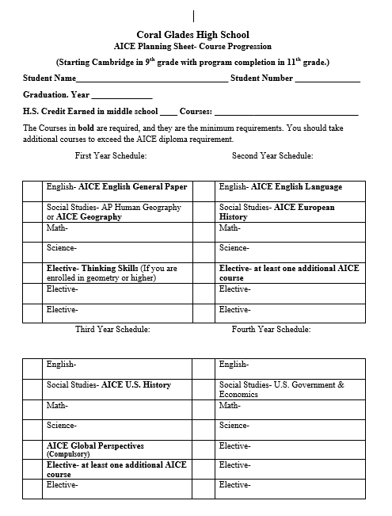
Course
Planning
Sheet

Slide 43

Coral Glades High School Graduates!
Massachusetts Institute of Technology
Harvard University
Emory University
Dartmouth College
Columbia University
Vanderbilt
Stanford University
Washington University in St. Louis
West Point Academy
Boston University
Brown University
University of Pennsylvania
Northwestern University
George Washington University
Cornell University
New York University
USC
Duke

Slide 44
Additional information can be found on the Coral Glades website! https://www.browardschools.com/coralglades
Email me at lisa.plass@browardschools.com

Slide 45

JUMP-START COLLEGE PRESENTATION
PRESENTERS:
BRACE ADVISOR:
MRS. RAFF

Slide 46
THE COLLEGE APPLICATION PROCESS
RESEARCH THE ADMISSION REQUIREMENTS FOR UNIVERISITES NOW
APPLY EARLY, DON’T WAIT UNTIL SENIOR YEAR
WHEN APPLYING MAKE SURE YOU HAVE A COMPLETE APPLICATION
YOU MUST SEND SAT/ACT SCORES THROUGH WEBSITES
MAKE SURE YOU SEND YOUR ESSAY IF REQUIRED
REQUEST TRANSCRIPT THROUGH NAVIANCE OR SSAR
DON’T CHANGE YOUR SCHEDULE ONCE TRANSCRIPT SENT

Slide 47


TEST PREP RESOURCES
KHAN ACADEMY
BROWARD COUNTY’S PUBLIC LIBRARY: https://www.broward.org/Library/Pages/SATACTProgram.aspx
Schoolhouse.World
App Store- ACT & SAT prep- FREE

Slide 48

SERVICE HOURS
NEEDED FOR BRIGHT FUTURES, GRADUATION, SILVER CORD
DON’T WAIT UNTIL SENIOR YEAR TO SUBMIT/COMPLETE
40 hours to graduate- 250 for a silver cord ;o)
VOLUNTEERMATCH.ORG
Humane Society
HANDSONBROWARD.ORG
Local Municipalities
Check with your place of worship, library,

Slide 49
RECOMMENDATION LETTERS
GIVE RECOMMENDER TIME: UP TO 2 WEEKS
NOT NEEDED FOR ALL INSTITUTIONS
ASK RECOMMENDERS WHO KNOW YOU WELL

Slide 50
SCHOLARSHIPS
Check with your BRACE Advisor
APPLY FOR FAFSA AND BRIGHT FUTURES OCTOBER OF SENIOR YEAR
CHECK XELLO
ATHLETES
REGISTER FOR THE NCAA-VISIT ELIGIBLITY CENTER.ORG
CONTACT COACH AT INSTITUTION

Slide 51
DUAL ENROLLMENT/EARLY ADMISSIONS
SENIOR YEAR: THREE CLASSES
TWO AT BC, ONE AT FHS
ALL THREE AT FHS
EARLY ADMISSION
12 CREDITS EACH SEMESTER
TAKE CLASSES NEEDED TO GRADUATE
IF YOU DO POORLY
WILL NEED TO HAVE A SCHEDULE FOR NEXT SEMESTER

Slide 52

XELLO
REQUEST TRANSCRIPTS AND MANAGE YOUR APPLICATIONS
UPDATE EMAIL FOR BOTH YOU AND YOUR PARENTS
SCHOLARSHIP SEARCHES AND MORE

Slide 53

FINISH STRONG
YOU’VE GOT THIS

Slide 54


CORAL GLADES ATHLETICS

Slide 55
FALL SPORTS
FOOTBALL
VOLLEYBALL(G)
CROSS COUNTRY
GOLF
JULY 29TH START DATE
ONLINE REGISTRATION MUST BE COMPLETED BY JULY 1ST

Slide 56
WINTER SPORTS
BASKETBALL—OCTOBER 28 START DATE
SOCCER—OCT. 14 START DATE
COMPETITIVE CHEERLEADING
ONLINE REGISTRATION MUST BE COMPLETED BY OCTOBER 1ST

Slide 57
SPRING SPORTS—START DATE JANUARY 15
BASEBALL
SOFTBALL
FLAG FOOTBALL
VOLLEYBALL(B)
TENNIS
WATER POLO
TRACK AND FIELD
LACROSSE
ONLINE REGISTRATION MUST BE COMPLETED BY DECEMBER 1ST

Slide 58
ONLINE REGISTRATION
VISIT THIS PAGE
https://www.browardschools.com/Page/78414
Must Upload:
Recent physical(must use new EL2 form)
Proof of insurance
Must watch 4 videos and upload certificates of completion:
Cardiac, Heat, Concussion, Bullying/Hazing

Slide 59
CGHS ATHLETICS CONTACT INFORMATION
HOWIE SCHRAGER—ATHLETIC DIRECTOR
hschrager@browardschools.com
RALPH RUBIANO—ASSISTANT ATHLETIC DIRECTOR
ralph.rubiano@browardschools.com
ALISON MADEJ—ASSISTANT ATHLETIC DIRECTOR
alison.madej@browardschools.com

Slide 60


Coral Glades High School
Clubs and Organizations
Assistant Principal- Mr. Jassem
ICC Advisor- Mrs. Pein-Gates

Slide 61
Clubs
Types of Clubs
1. Class 4. Co-Curricular
2. Honor Societies 5. Service
3. Academics Games 6. Hobby

Slide 62
Class
Freshmen Class
Sophomore Class
Junior Class
Senior Class

Slide 63
Honor Societies
National Art Honor Society | National Tech Honor Society
National English Honor Society | Quill/Scroll Honor Society
National History Honor Society | Science National Honor Society
National Honor Society | Spanish Honor Society

Slide 64
Academics Games
ESOL | Science
Language Arts | Social Science
Math | World Language

Slide 65
Co-Curricular, Service, and Hobby Clubs
Art Club | Debate/Forensic
Asian American & Pacific Islanders | DECA
Battle of the Books | Democracy First
Black Student Union | Drama Club
Caribbean Student Association | Education Rocks
Coding | Engineering Design
Crochet | FCCLA
Dance | First Priority

Slide 66
French Club | Mentoring Tomorrow’s Leaders
Future Educators of America | Modern Music Masters
Girl Up! | Mu Alpha Theta
GSA | NERD Coalition
HOSA | Newspaper
Interact | Peer Counseling
Key Club | Peer Palz
Latinos in Action | Poetry
Make Our School Safe Club | Robotics/Drills/Raiders

Slide 67

SADD | Student Law Association
Save Promise | Student Muslim Association
Save What’s Left | Technology Club
Student Government Association | TV Production
Shanti Club | UNICEF Club
SHELL Club | Women of Tomorrow
Spanish Club | Yearbook

Slide 68
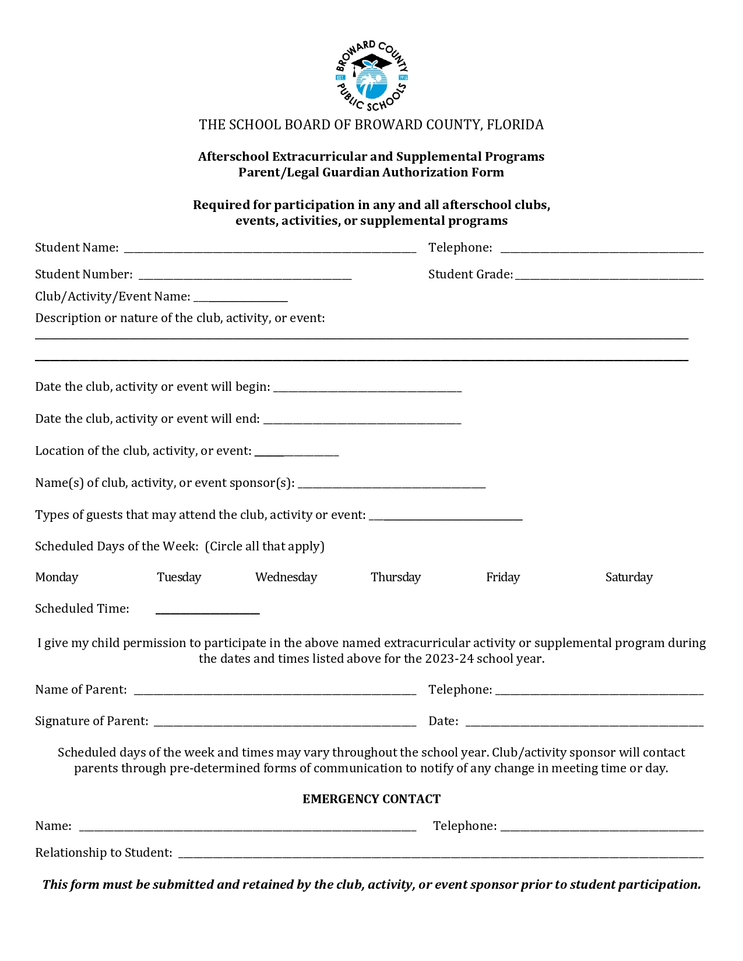
Parent/Guardian Permission

Slide 69

Jaguar Expedition
Incoming students are invited to attend.
Orientation will include the following:
​
-Workshops: Academics, Clubs, & Sports
-Activities
-Clubs/Organizations Meet and Greet
-Textbook/ Schedule Distribution - -Lunch
-Campus Tour
-Jaguar Spirit Shirt
Student Government Association @coralgladessga

Slide 70
Contact Information
If you have any questions or concerns, please feel free to contact Mrs. Pein-Gates at
Caitlin.peingates@browardschools.com

